Slide 1

ScoutEnd

Slide 2

Overview
ScoutEnd is a system designed to predict football player performance and provide clubs with scouting recommendations based on an analysis of their past performance data. The system uses past performance data to help clubs make better decisions when choosing to invest in players by identifying those with the highest potential to make the greatest impact.

Slide 3

ScoutEnd’s Objectives
ScoutEnd is designed to transform the way football teams scout players by harnessing the power of data and machine learning. Our primary objective is to identify rising stars and efficiently improving squads through insightful predictions and analyses of player statistics.
Effective player scouting is more important than ever. It empowers teams to discover hidden talents who can become pivotal players, maximizing their potential and paving the way for future successes.
Because it was originally inspired by the Moneyball concept that focuses on using data analytics to identify undervalued players and make cost-effective decisions. This project can contribute to a club’s financial success, where the idea of “Buy low, sell high” could apply to players if you scout them early on.

Slide 4
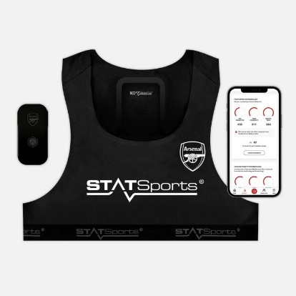

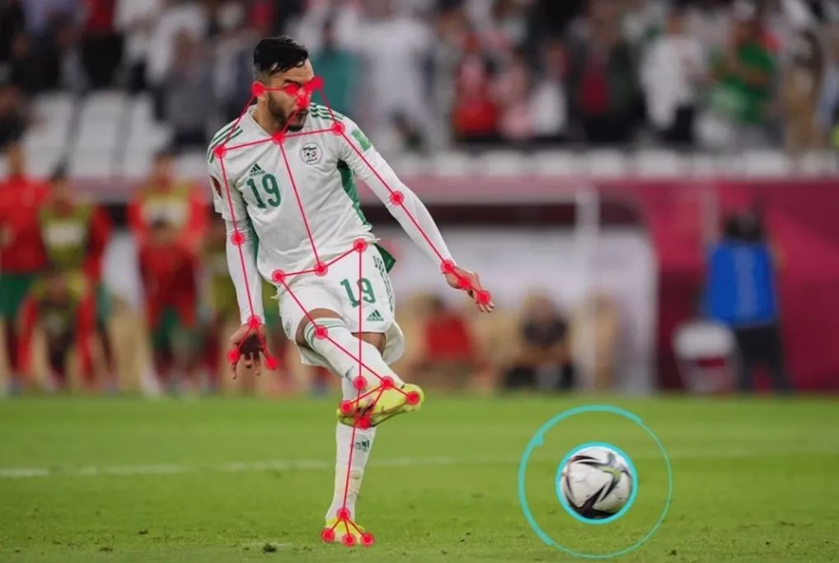
Data and Sports Analytics
Due to technological advancements, the sports field was set to drastically change. How? New evices that can track everything—player movements, ball trajectories, and even pitch conditions—generating a flood of data. This wealth of information, if used correctly, empowers teams to make smarter decisions, from optimizing training to spotting talent, as seen in this project. By harnessing this data, clubs can gain a competitive edge, transforming the way of sports as you can now optimize almost everything.

Slide 5

Data and Football
Data analytics has emerged as a game changer in sports. By leveraging extensive datasets, teams can gain unparalleled insights into player performance, trends, and behaviors. Data analytics has transformed sports by enabling evidence-based decision-making, from player recruitment to performance optimization. Clubs leverage metrics identify talent and strategize, reducing reliance on subjective scouting.
For example, Liverpool FC used data analytics in to sign Mohamed Salah, Alisson and Virgil Van Dijk using their performance metrics, be it offensive or defensive, which contributed to their Champions League success. ScoutEnd applies similar principles, using comprehensive player data to enhance prediction accuracy and scouting efficiency.

Slide 6
Data Collection
Data was collected from Europe’s biggest 5 leagues.
The data spanned the last 5 seasons from 2020 up to 2024
Python was used to collect the data using web scraping and storing it in .csv files.
This was to ensure that we have a reliable dataset with relevant information.
2020 2021 2022 2023 2024

Slide 7







Data Sources and Features
FBREF: A major website that tracks seasonal statistics for player performances.
General player Info: Name, Age, Nationality, Team, League
Attacking Metrics: Goals, Assists, xG, xA, Shots, Shot Creating Actions (SCA)
Passing Metrics: Pass Completion, Key Passes, Progressive Passes
Defensive Actions: Tackles, Interceptions, Blocks, Clearances
Playing & Appearances: Matches Played, Minutes Played, Substitutions
Team Performance: On Field impact, Points Per Match Per Appearance
SoFIFA: A website that tracks metrics that are used in the game Fifa. While used in the game, some of these features could be used in real life as well.
Phyiscal Attributes: Player Speed, Height, Weight
Player Price
Position Related: Preferred Foot, Best Position

Slide 8

Data Cleaning
Filled null values and removed duplicates
Removed players with zero playing minutes as they would cause noise and have no use.
Made sure that all data attributes have the correct data type
Outliers were kept as they are needed in our data

Slide 9

Data Integration
A Challenge:
Since we gathered two different datasets with different features and different amount of rows we had to integrate them. But there was a problem with player name formats i.e.
Long Name: Lionel Andrés Messi
Short Name: Messi
Fame Name: Lionel Messi
To integrate and concatenate both datasets we had to:
Parse and use exact matching
Match using long name
Match using partial matching
Use Fuzzy matching with similarity scores
Both datasets were successfully integrated with minimal losses to finalize the dataset used for our interface.

Slide 10

Machine Learning Modeling
The goal of using machine learning here is to predict a player’s goal and assist performances using data from previous seasons. Giving us a look at a player’s future.
While there are a lot of unpredictable and unmeasurable outside factors that affect what we try to predict such as injuries, mental health, the quality of the league, player transfers affecting playtime and more.
However, we tried to get the most we can out of the data that we have.

Slide 11

Feature Engineering – Part 1
General Features:
Age: Derived from birth year.
Age Decline: Penalty of -0.1 per year over 32 years old.
Team Strength: Ratio of team goals scored to league average goals.
Minutes per 90: Minutes played per 90 minutes.
Minutes per 90 trend: Percentage change in minutes per 90 minutes per season.
Positional Flags: Dummy flags for each position (FW, MF, DF)
Goal Related Features:
Goal Conversion Rate: Ratio of goals to shots on target.
xG Overperformance: Difference between actual goals and expected non-penalty goals.
Shot Accuracy: Ratio of shots on target to expected non-penalty goals.
Gls trend: Percentage change in goals per season per player.
Recent xG Form: Rolling mean of expected non-penalty goals over two seasons.
Adjusted Goal Rate: Goals per 90 minutes with a 30% boost if >20 goals.
Goals Delta: Mean difference in goals between consecutive seasons per player.
Gls per 90: Goals per 90 minutes.
Gls per 90 trend: Percentage change in goals per 90 minutes per season.
Breakout Signal: Product of Gls_per_90_trend, Minutes_per_90_trend, and team goals scored (weighted).

Slide 12

Feature Engineering – Part 2
Assist Related Features:
Assist Conversion Rate: Ratio of assists to expected assists.
xA Overperformance: Difference between actual assists and expected assists.
Ast trend: Percentage change in assists per season per player.
Ast per 90: Assists per 90 minutes.
Ast_per_90_trend: Percentage change in assists per 90 minutes per season.
Recent xA Form: Rolling mean of expected assists over two seasons.
Adjusted Assist Rate: Assists per 90 minutes with a 30% boost if >10 assists.
Breakout Signal: Product of Ast_per_90_trend, Minutes_per_90_trend, and team goals scored (weighted).

Slide 13

Model Selection
Model Selection: After testing around with different models, RandomForestRegressor, XGBoost, and LightGBM were selected for their effectiveness in regression tasks, handling non-linear sports data with 50+ features. Random Forest provides stability via bagging, XGBoost enhances precision with gradient boosting, and LightGBM offers efficiency, those models were chosen for interpretability and computational feasibility.
While each of the models had its own results, upon looking at each result we found:
Some models would capture the trends of proven players that are already known only while missing the others
Some models would capture average players only and would predict inaccurate numbers for superstars.
Some models would capture the smallest trends to identify potential players with limited statistical numbers.
The final model was an Ensemble that combines all 3 models and takes a percentage or weight from each of the 3 chosen models’ predictions.

Slide 14
Model Training
The training process went like this:
Trained the model to predict goals for just forward players using with 2020-2023 as the training dataset, and 2024 as the testing dataset. The model had to be fine tuned, and more features were added with feature engineering. MAE was good but could be better.
Retrained the model but this time for all positions, which increased the data pool that models could use for training. MAE significantly improved.
Trained a model for assists same as the goals model. MAE was as good as the goals model.
Retrained both models however this time the 2024 data was also added to the training data. We acquired data from 2025’s unfinished season at the time, this was to test the retrained model. This was done to keep up with football’s changing rhythms and to see if the model could work with newer data. The results for the MAE were on track as projected.

Slide 15
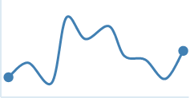
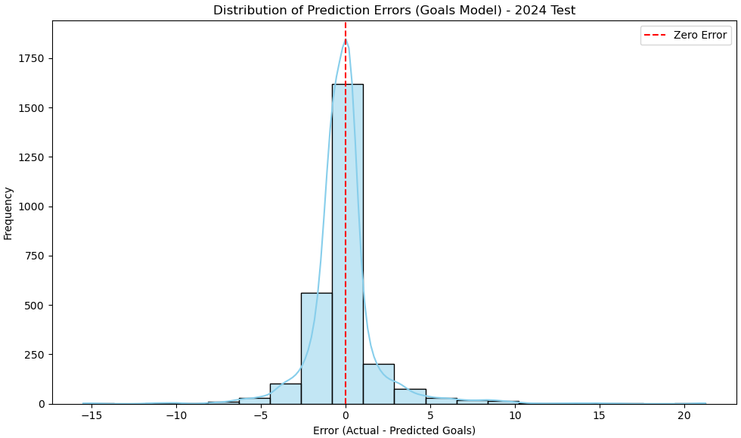
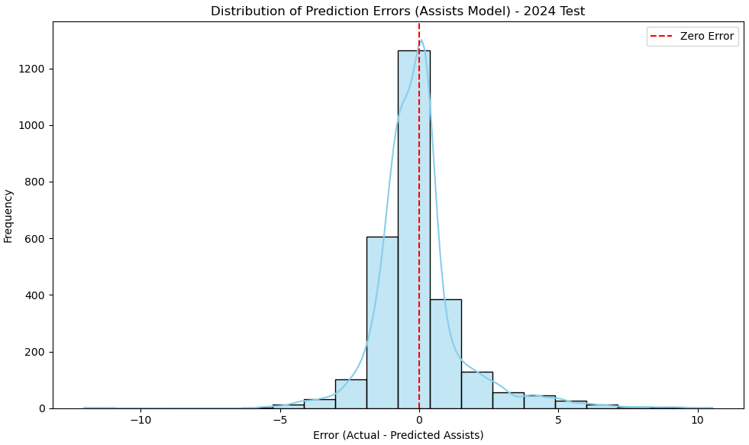
Performance Metrics
To gauge our model’s success, we use rigorous performance metrics like Mean Absolute Error (MAE), which measures average prediction error in discrete units like goals and assists, aligning with our focus on accurate player performance predictions.
These are the results :

Slide 16
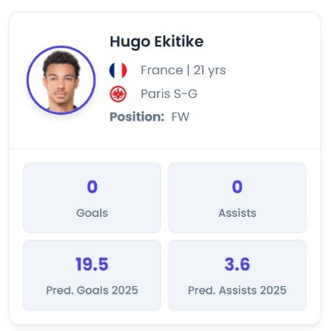
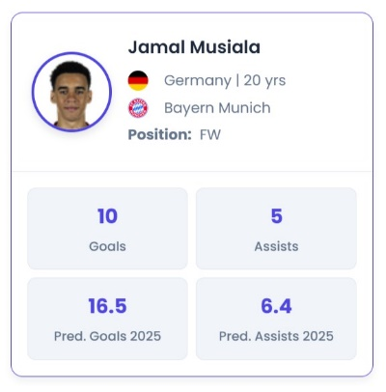
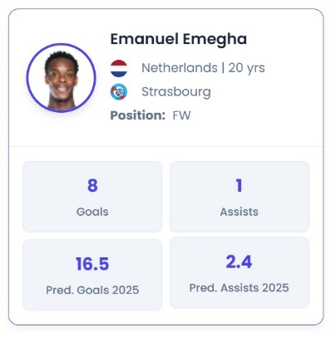
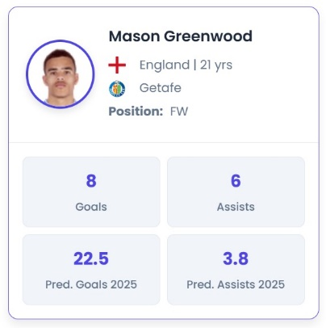
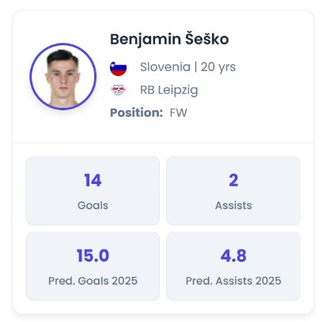
Prediction Results – A Sample
Goals: 15
Goals: 12
Goals: 14
Assists: 8
Assists: 2
Assists: 3
Goals: 21
Goals: 13
Assists: 5
Assists: 5

Slide 17
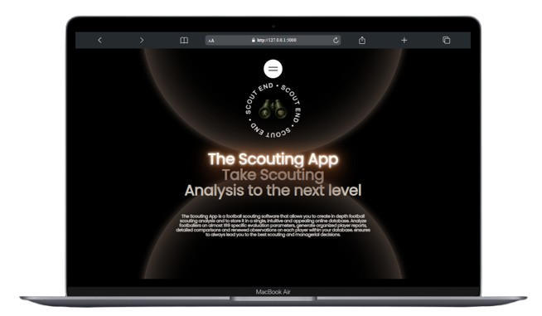
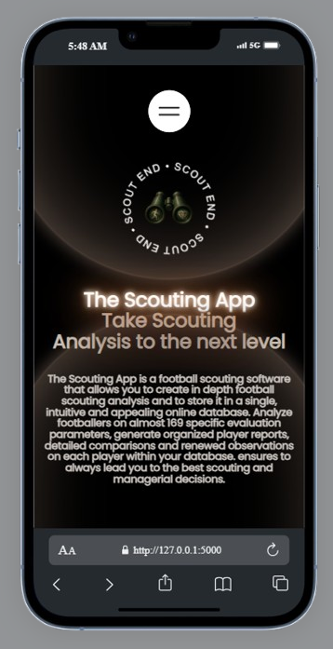
Our Web Interface ANALYZE PLAYERS – SCOUT GEMS – BUILD SQUADS

Slide 18

Interface Tools Used
Frontend:
HTML5, CSS3, JavaScript
Tailwind CSS for styling
Alpine.js for interactive UI components
Chart.js for data visualization
Marked.js for markdown parsing
Backend:
Flask (Python web framework)
Python libraries:
pandas for data manipulation
scikit-learn for machine learning (cosine similarity)
Plotly for advanced visualizations
NumPy for numerical operations
APIs:
Google Gemini API for AI-powered analysis
Supabase for authentication and database

Slide 19

Future Developments
Integrate live data updates for real-time performance tracking.
Be more global by expanding our data sources to include emerging leagues from Africa, Asia, South America and even lower leagues in Europe.
Expand to other tournaments not just domestic leagues.
Introduce a paid model for premium features and sustainability.
Develop advanced visualizations like interactive heatmaps.

Slide 20

Conclusion
In conclusion, ScoutEnd is not just a tool; it's a game-changer for football scouting. By combining technology with passion for the sport, we inspire clubs to rethink their scouting methodologies, optimize player recruitment, and ultimately enhance the beautiful game.

